Slide 1
Project Demo : Object Detection (classification & localization) (Using Weakly Supervised Learning) Pattern Recognition (EEL6825) – Dr. Dapeng Wu
Submission By :
Vikas Chaubey Email : vikas.chaubey@ufl.edu , UFID : 3511 5826 Department of Computer and Information Science and Engineering ,University of Florida Gainesville, USA

Slide 2
Contents:
What is Object Detection?
Types of Object Detection Scenarios
Existing Object Detection Techniques
Traditional Object Detection Techniques using Machine Learning and their Pros and Cons
Deep learning-based Object Detection Techniques and their Pros and Cons
Object detection using Weakly Supervised Learning
Convolution neural networks
Gradient weighted Class activation mapping (Grad-Cam Algorithm)
Project Architecture and workflow
Project demo
Performance Evaluation
Conclusion

Slide 3
What is Object Detection?
Object detection is a computer vision technique which allows the computer algorithms to identify an object of a certain class and locate that object within given visual data such as image or video.
The Process of object detection can be further divided into three separate subtasks :
Object recognition (identification of presence of any object in visual media)
Object classification (classifying recognized object among given classes or categories)
Object localization (locating the position of object within the visual media)

Slide 4
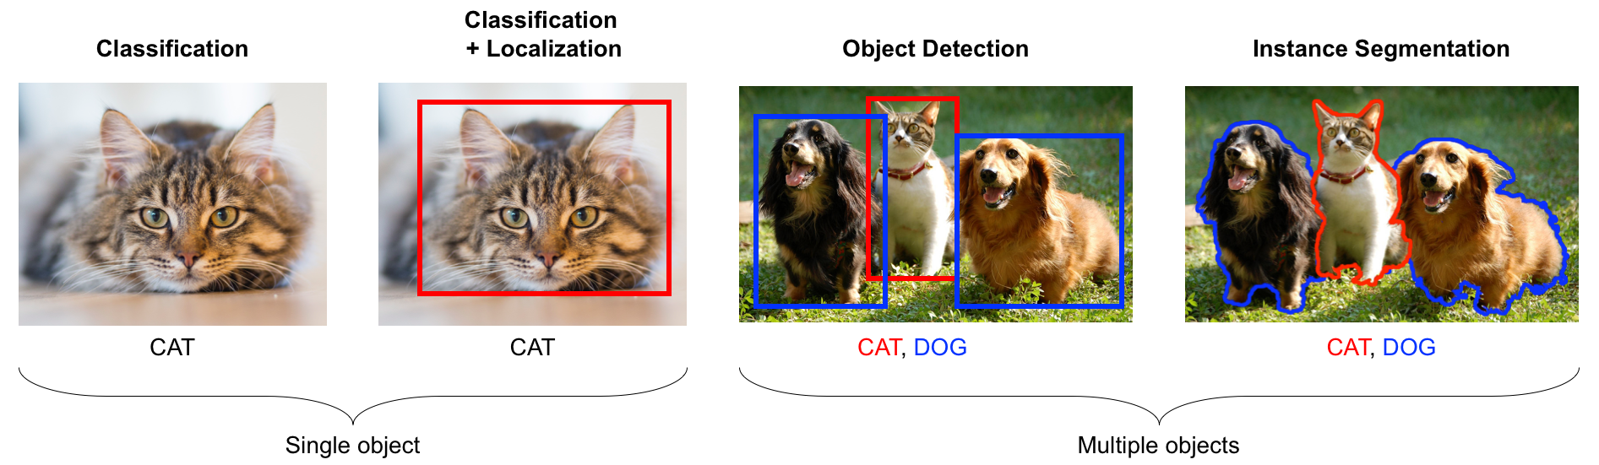
Object Detection Examples :

Slide 5
Types of Object Detection Scenarios:
Single Class Single Label (An Algorithm that can detect and locate only one type of object category and label it In the given image for example an algorithm which can only identify cats in given images)
Multi Class Single Label (An Algorithm that can detect and locate multiple types of object categories such as dogs, cats, birds etc but it labels only one category at one time in a given image)
Multi class Multi Label (An Algorithm that can detect and locate multiple types of object categories such as dogs, cats, birds and can also label multiple classes of identified objects at one time in a given image)
This project implements Multi Class Single label object detection algorithm , Among five different Animal class categories , which are : [ Dog, Cat, Frog, Mouse, bird ]

Slide 6
Existing Object Detection Techniques:
The Object detection techniques can be divided into two categories
Traditional Machine Learning approaches : The traditional machine learning approaches involve computer vision techniques such as as feature descriptors SIFT(Scale-invariant feature transform) ,SURF (Speed-ed-Up Robust Features),BRIEF etc. for object detection. All these techniques require feature extraction from the data which are also called descriptors or informative segments .
Deep learning-based object detection methods : Deep learning is the branch of machine learning which uses neural networks in order to solve the standard machine learning problems. some effective neural networks which are used for object detection are CNN(convolution neural networks), R-CNN, Fast R- CNN, Faster R-CNN, Retina-Net, Deform able convolutional networks etc. Some deep learning-based approaches such as YOLO(V2), YOLO(V3) are some of the most popular deep learning solutions for object detection

Slide 7
Traditional Machine Learning Object detection approaches
SIFT(Scale-invariant feature transform) :In this technique Image descriptors are first extracted from the reference data and saved in the data base prediction for the new image input is made based on the comparison of new image description with the saved classes in database.
SURF (Speed-ed-Up Robust Features) : This technique is composed of two-part feature extraction and feature description; feature extraction is done using basic Hessian matrix approximation feature description is similar to SIFT.
Other traditional object detection techniques are Harris corner detector, FAST (Features from accelerated segment test), BRIEF(Binary Robust independent Elementary features) , ORB(Oriented FAST and Rotated BRIEF)

Slide 8
Pros and Cons of traditional Machine Learning object detection algorithms:
Pros :
1) Produce good results if feature engineering is done correctly.
2) Require less reference data for training
Cons
1) Feature extraction for preparation fo data sets is done by human intelligence
2) data preparation is time taking

Slide 9
Deep learning-based object detection methods
Deep learning is the branch of machine learning which uses neural networks in order to solve the standard machine learning problems.
What Are neural Networks? Neural networks are a set of algorithms, modeled loosely after the human brain, that are designed to recognize patterns. They are comprised of small units which are interconnected, and function together called neurons just like human brain neuron cells hence the name neural network.
Special types of neural networks such as CNN(convolution neural networks), R-CNN, Fast R- CNN, Faster R-CNN networks and algorithms like YOLO(v2), YOLO(V3) are very popular deep learning approaches for object detection

Slide 10
Pros and Cons of Deep learning based object detection algorithms:
Pros :
1) Proved to be accurate
2) Can do feature extraction by itself
Cons
1)Needs large volume of data for training
2) data preparation is time taking
3)Data annotation is required for object localization training
3) Traininig Time is more
3) Requires more processing power for training

Slide 11
Object detection using Weakly Supervised Learning
This project implements multi class single label object detection algorithm using convolution neural network with weakly supervised learning
In order to train neural networks for the task of object detection(classification and localization) the training data set must be prepared in a certain way for :
1) classification : training data set must be labelled(class or category names)
2) localization : training data set should be annotated with bounding box
This could be an expensive and time taking process if the datasets are large.
What is weakly supervised learning ? Weakly supervised learning is a machine learning technique where the neural network model is trained using data samples that are only partially annotated or labeled.
Weakly Supervised Learning could be used to reduce data preparation efforts for object detection.

Slide 12
Weakly Supervised Learning
With Weakly supervised learning the neural network can be trained using only labelled data.
With Weakly supervised learning neural network training does not require data to be annotated with bounding boxes.
Big Question ?
If Labelled data(class or category names) can only train a neural network for task of classification and bounding Boxed annotated training data is required for localization, then if data is only labelled then how will neural network be trained for the task of localization.
Answer : Gradient Weighted Class Activation Mapping (Grad- Cam Algorithm) can be used to localize object without explicitly training a model for the task of localization.

Slide 13
Weakly Supervised Object detection using CNN and Grad-Cam Algorithm
The concept of weakly supervised learning for object detection is implemented ion following manner:
1) Prepare only Labelled data set with class category names
2) Train a convolution neural network with this labeled data for task of classification
3) Use gradient weighted class activation Mapping algorithm to do localization : Grad- Cam algorithm can do localization by utilizing the outcomes obtained from the last convolution layer of Convolution neural network This eliminates the requirement to train the neural network separately for task of localization.

Slide 14
Convolution Neural Network (CNN)
The convolution neural network is a special type of neural network , these networks are called convolution neural nets because they perform the operation of convolution in convolution layers, these networks perform very well on visual image data to extract image features.
Why Convolution neural networks are preferred over general neural networks for object detection?
Unlike general neural networks Convolution neural network imitates the vision functionality of human brain hence CNNs are very efficient at processing visual data that’s is why CNNs are preferred over general neural networks for object detection tasks.
In this project Implementation the CNN architecture which is used is VGG-16 which is a standard architecture used in various object detection algorithms.

Slide 15
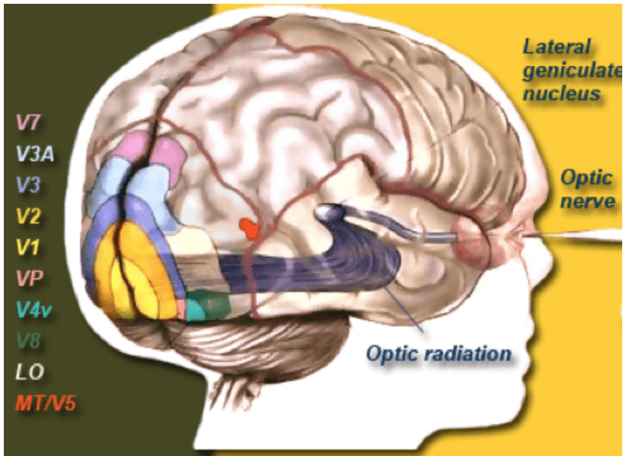
CNN and Human Brain (visual Cortex)
Visual cortex is the part of human brain which is responsible to process visual imagery seen by human eyes.
The visual cortex is comprised of different layers
The visual data seen by eyes is processed in those layers sequentially , for example initial layers identify the basic features of visuals such as shapes , edges etc and last layers are responsible to extract detailed information such as context from the visual data.
For visual imagery seen by eyes only this portion of brain is activated not the other parts of the brain.(i.e. only certain neurons react to the visual stimulus, loose coupling of neurons)

Slide 16
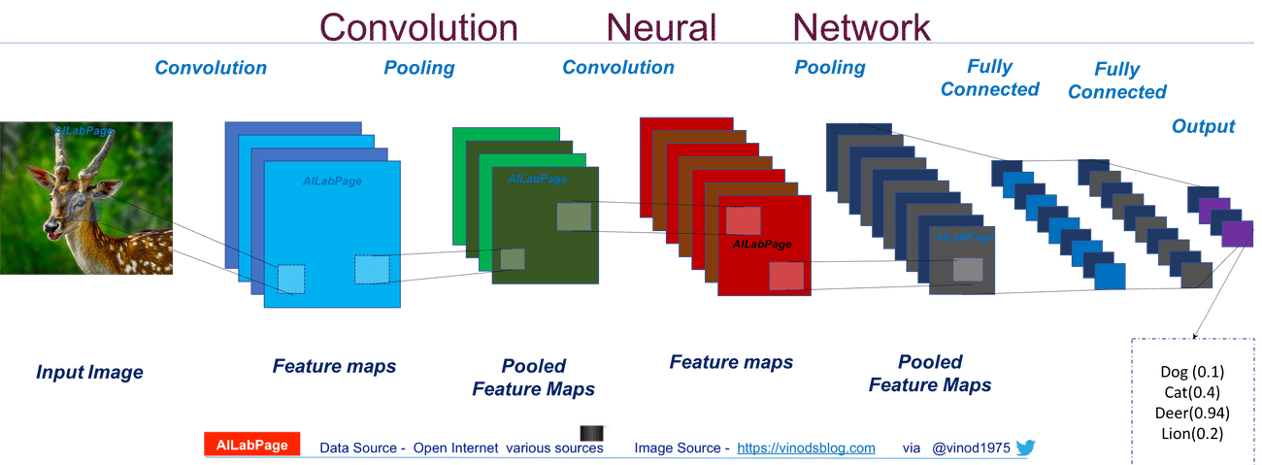
The Design of Convolution Neural Network
Convolution Neural networks are designed to function and imitate the functionality of visual cortex of human brain
1) like Visual cortex Convolution neural networks also have various layers which process data sequentially some layers are convolution layer, Max Pooling , dense layers etc.
2)Like visual cortex convolution neural network have loose coupling of neurons i.e. neuron units are not densely connected with every single other neuron in different layers. This type of architecture reduces the computation of model parameters hence CNNs can work faster.

Slide 17
Layers and Functionality of A convolution Neural network
Architecture of convolution neural network mainly comprised of following layers:
1) Convolution Layer: The convolution layer is comprised of many filters also called as kernels of certain dimensions, in this layer these filters are convolved with image input and class activation maps are generated. number of class activation maps depend upon the number of filters present in this layer. with the help of those class activation maps the convolution layers learn the features of visual data.
2) Pooling Layers : The class activation maps generated in the convolution layer are fed to the pooling layers. This layer performs the function of max pooling, down sampling and sub sampling. For example in max pooling sampling is done in such a way that in these layers Only the locations on the image that showed the strongest correlation to each feature are preserved, and other values are ignored. Subsequently the outcomes of this layer are fed to the next convolution layer.
3) Dense layers (Fully connected layers) : final outcomes or stacked class activation maps are finally fed to the feed forward network which is fully connected, and this network performs the classification by using the data and an activation function.

Slide 18
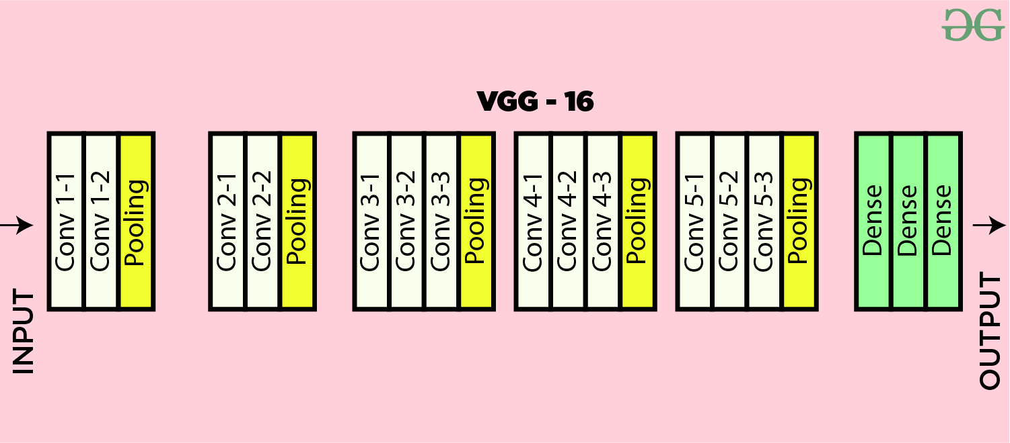
Architecture of VGG-16 :
This project uses the convolution neural network - VGG-16 architecture which is very popular for tasks related to computer vision because of its high accuracy.
VGG-16 architecture comprised of :
1) 13 convolution layers which perform convolution operation
2) 5 Max Pooling layers which perform max pooling(Operations like down sampling, max pooling etc.)
3) 3 Dense layers which are responsible to generate final classification output.
Hence the convolution neural networks consist of total 21 layers out of which only 16 layers are weighted.

Slide 19
Gradient Weighted Class Activation Mapping(Grad Cam Algorithm)
What are class activation Maps? Class activation maps are the descriptive regions used by convolution neural network in the convolution layers in order to identify the class or category of the image input.
Grad- Cam Algorithm for localization : Grad Cam algorithm makes use of outcomes obtained from the last convolution layer which are stacked weighted feature maps and feed those feature maps to an activation function in order top produce heatmaps which in turn are used for generation of heat maps for localization.

Slide 20
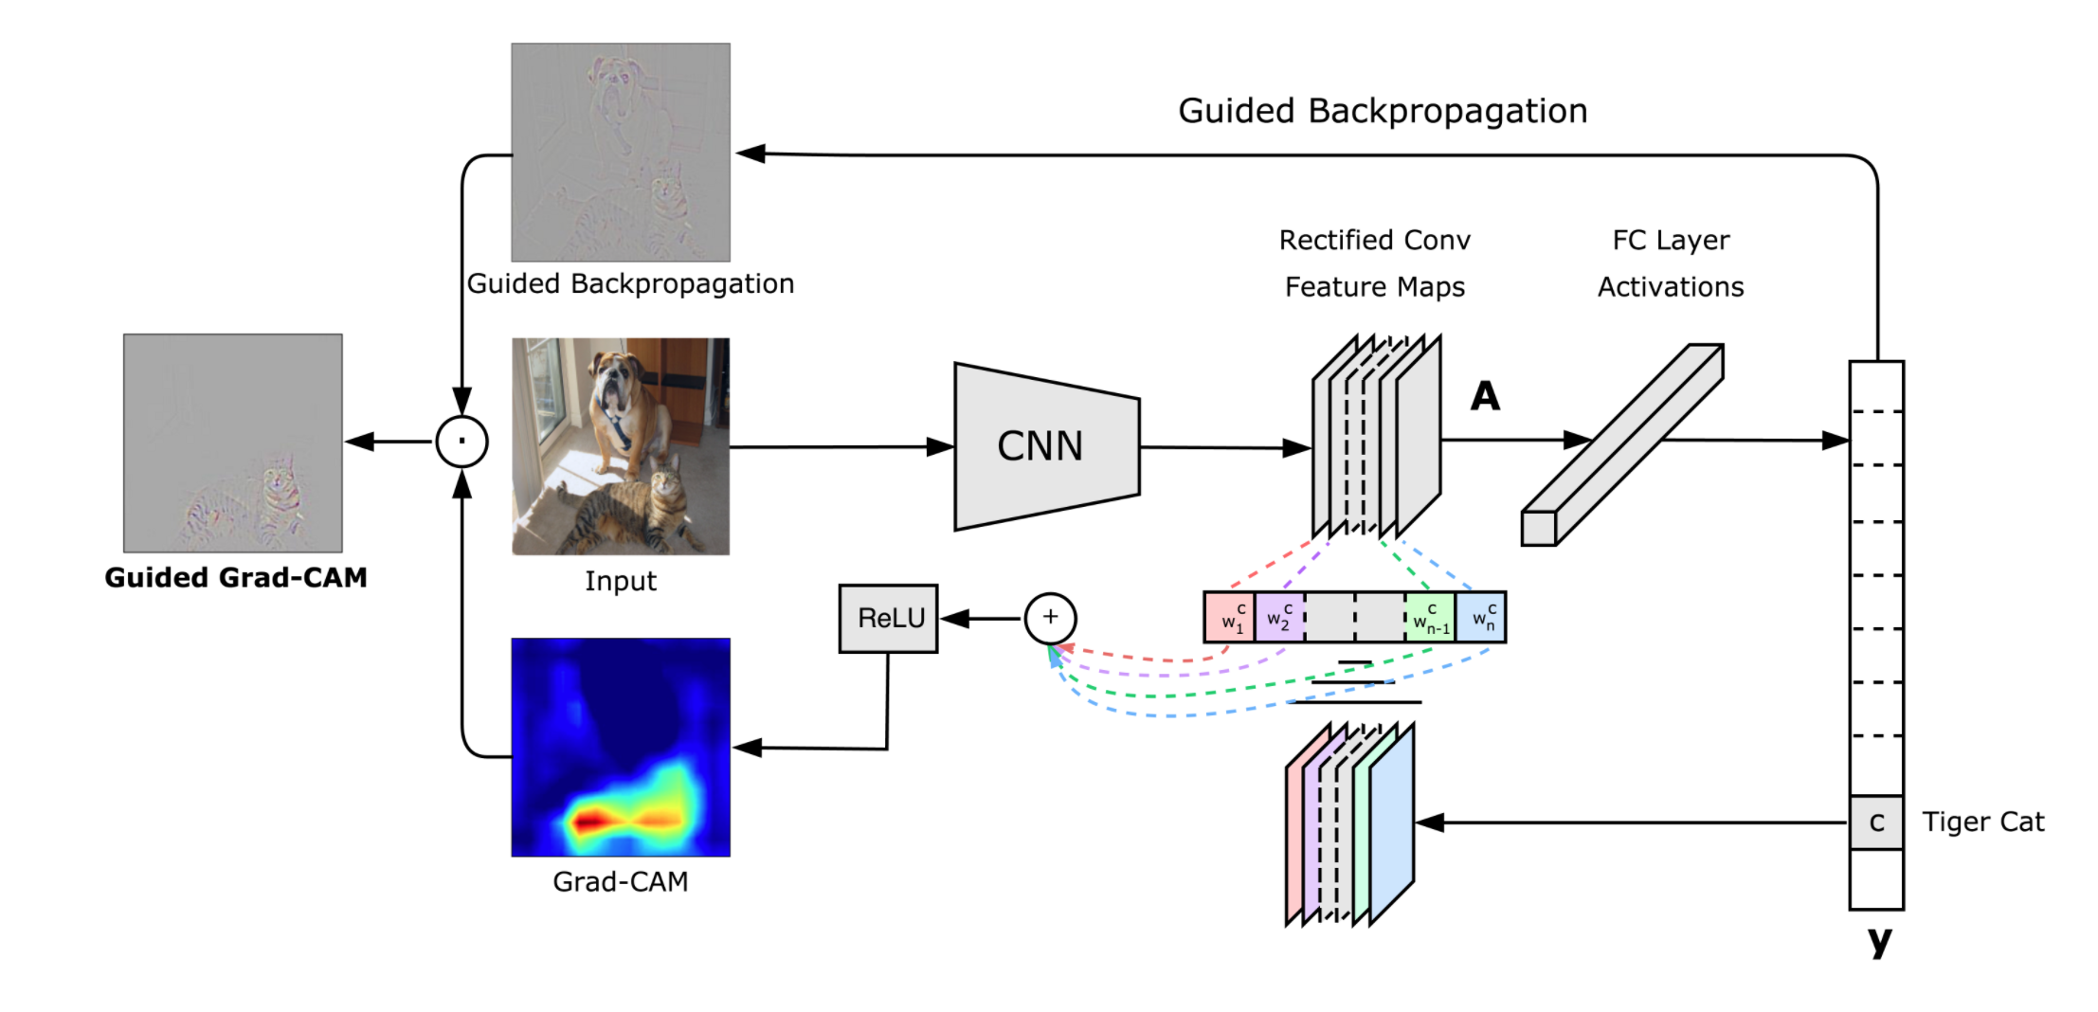
Gradient Weighted Class Activation Mapping(Grad Cam Algorithm)
To obtain the class-discriminative localization map, Grad-CAM computes the gradient of (yc) (score for class c) with respect to feature maps A of a convolutional layer.
Grad-CAM heat-map is a weighted combination of feature maps but followed by a Rectified linear unit activation function.
Utlizing this information Objects could be localized within the image.

Slide 21
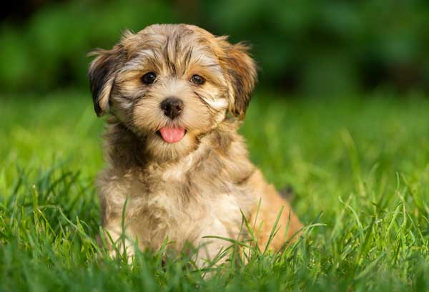
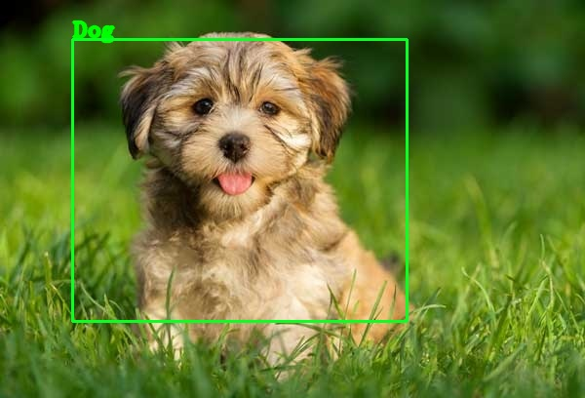
Project Application design and workflow :
Get the feature maps from the last convolution layers to produce heat maps
Display output with class name and bounding Box
Convolution Neural Network
(VGG-16)
Obtain Classification results
Grad-Cam Algorithm
OpenCV
Input Image
Classify image
Generate Localization maps and heat maps
Use Heatmaps to localize object with bounding Box

Slide 22
Training CNN model (VGG-16)
The CNN model is trained to classify and localize five different classes of animals (Dog, Cat, Bird, Frog and mouse).
For training of the model the data set is divided into 80-20 split, i.e. 80 percent of the images out of all available images in the data set are used for training remaining 20 percent images are used for validation testing of the model.
Out of total 7500 images obtained from ImageNet dataset for all 5 classes (Dog , Cat, Bird, Frog and mouse), 6500 images were used for training remaining 1000 images were used for validation.
the training data set is comprised of 1300 images per class (totaling 6500 images).While the validation data set consists of 200 images per class (totaling 1000 images).
Training was done for 50 epochs which took around 53 hours on local machine GPU.

Slide 23


Project Demo

Slide 24
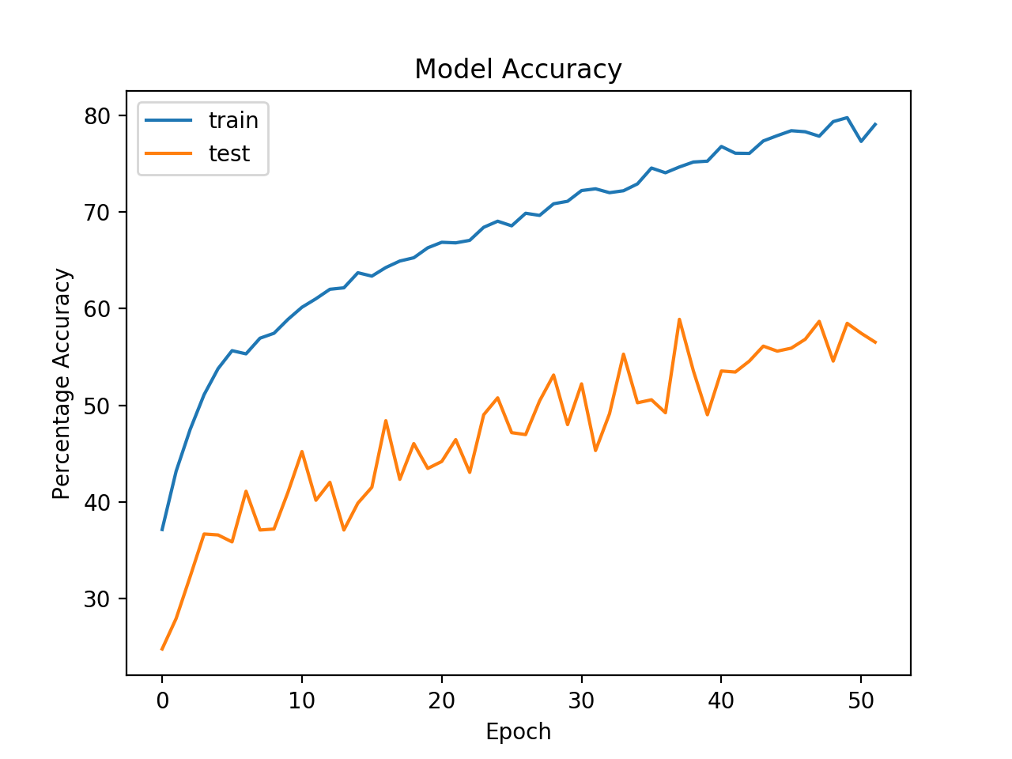
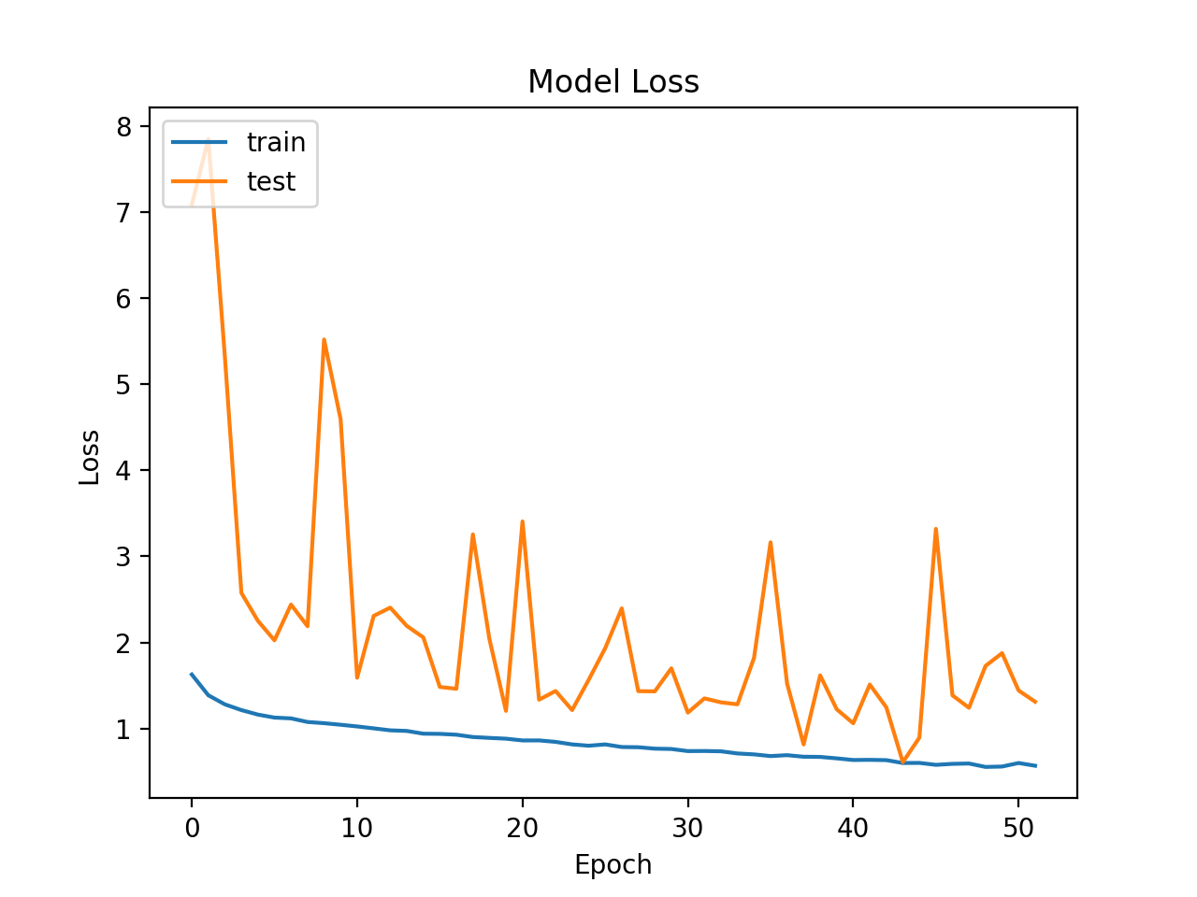
Performance Evaluation : Training
Model loss training set(0.56)
Model loss validation set(1.56)
Training set accuracy(77%)
Validation set Accuracy (56%)

Slide 25
Performance Comparison with YOLO(V3)
The performance comparison was performed on 500 test images obtained from ImageNet data set.
Project CNN Model accuracy was found to be 42%.
YOLO(V3) performance accuracy was found to be 67%

Slide 26
Conclusions:
Weakly supervised learning approach could be used to implement object detection algorithm where data sets are very large and data preparation costs are huge because of the data volume. In that scenario this approach can prove to be very useful and it can help to cut down data preparation costs.
After implementation of the model it was observed that Trained model is fast in producing results on test data.
The classification results obtained by the application are very accurate and percentage accuracy only for classification is nearly 70% on test data. But localization obtained is below average the percentage accuracy for localization is 36% on test data. Hence it could be said that Localization obtained using Grad-Cam algorithm is not very accurate.
CNN trained using weakly supervised learning for object detection is fast. It could be trained faster and it can predict outcomes faster compared to a neural network trained for both tasks.
The localization results depend highly upon the CNN classifier results hence in order to obtain good localization results the classifier should be trained with high accuracy.

Slide 27

Thank you

